Slide 2
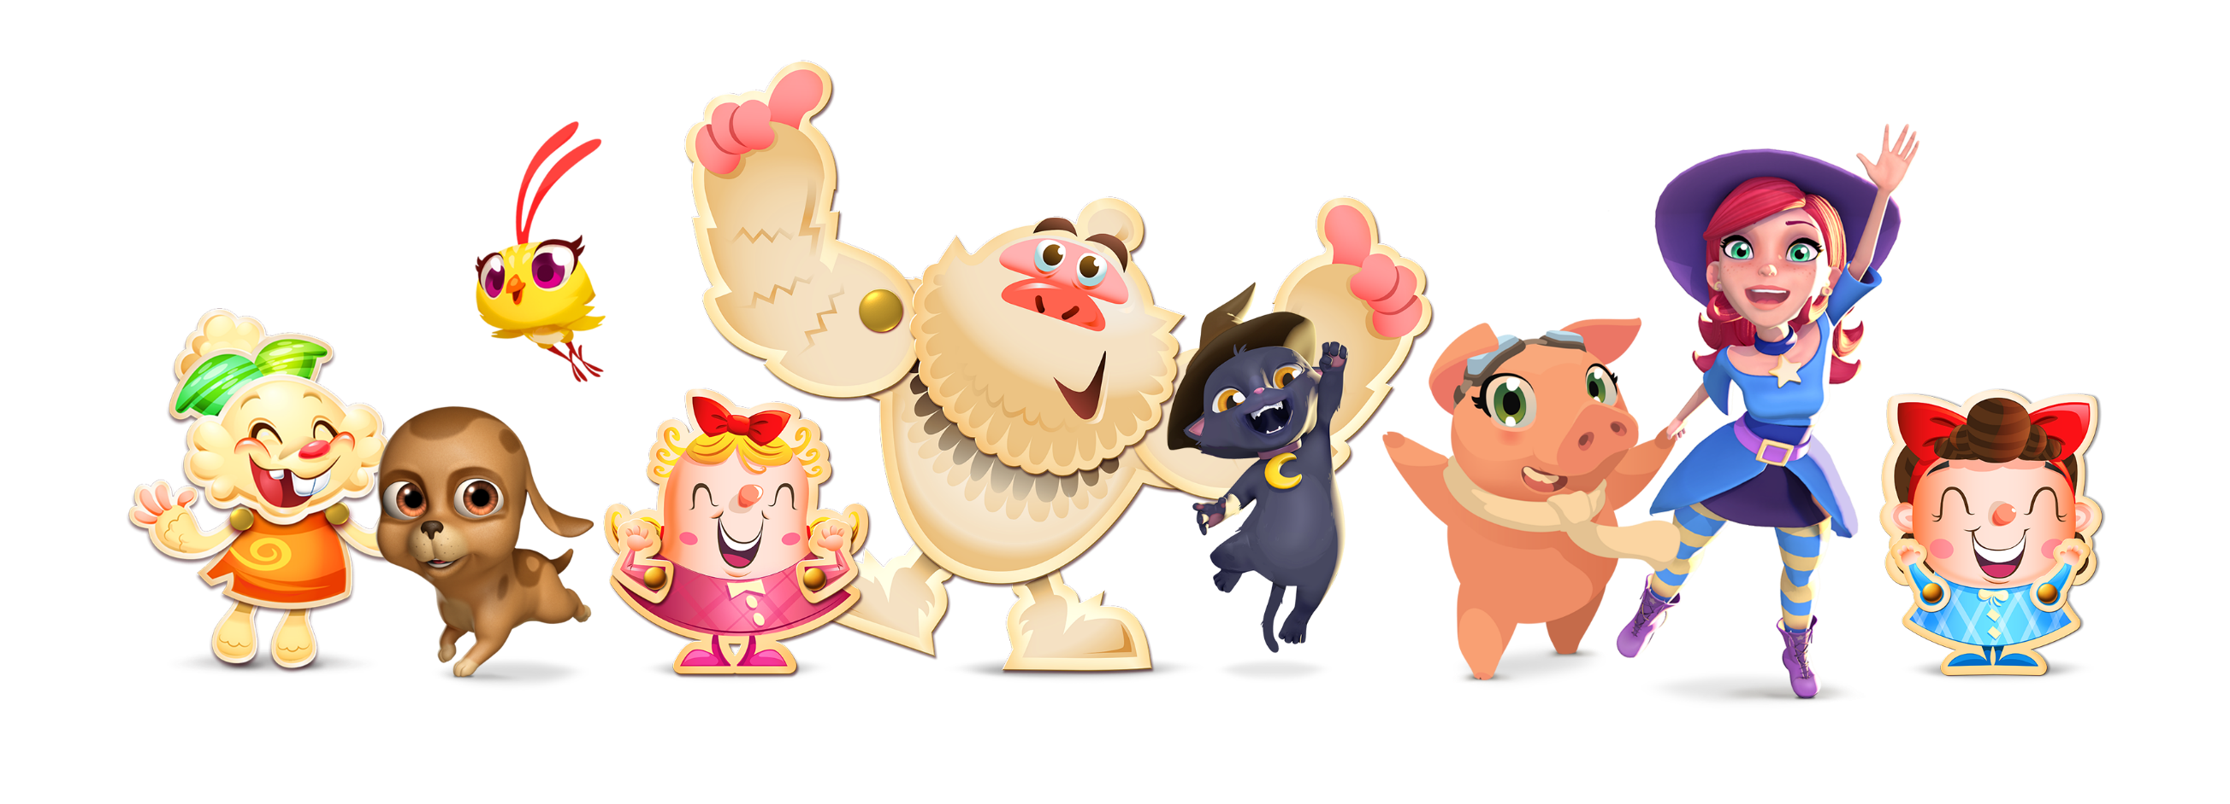
Business Performance Managers’ Case Study

Slide 3
Farm Heroes Saga Healing Lives Test

Slide 4
30min
Better engagement !
Group 5 minutes has 0.39% more churner
than Group 30 minutes

Slide 5
5 min
Group 5 minutes has in total 44244 converters than Group 30 minutes
Higher Gross Booking!

Slide 6
Why better engagement?

Slide 7
Higher efficiency on progression
Levels appear ”more difficult” for Group 5 min

Slide 8
Why higher gross booking?

Slide 9
Better on-boarding experience

Slide 10
Faster content consumption
117774 players from Group 5 min has reached the last level
88,5% more than Group 30 min

Slide 11
Further information
Volumn of converters on the same progression benchmark
Gross booking per episode
Total pay per user on the same progression benchmark
Group 30 minutes
Episode 1
Episode 10
Group 5 minutes
Episode 1
Episode 10

Slide 12
Higher gross booking might be an illusion

Slide 13
What do we do?

Slide 14
Before
After

Slide 15
Maintain previous configuration
Implement 30 min life regeneration , optimize on-boarding experience to improve 2DR

